Slide 1
Custom Headline

Slide 2
“Winnipeg looks for respect, on the ice and off it”
•••••••••••••••••••••••••••••••••••••••••••••••••••••••••••••••••••••••••••••••••••
ECONOMIC DEVELOPMENT WINNIPEG | YES! WINNIPEG

Slide 3
Why Winnipeg?
#1
most cost-competitive city across all of the U.S. and Western Canada
#1
lowest-cost location for select U.S. and Canadian businesses
(KPMG, 2016)
(Canadian Business Magazine, 2016)
top7
intelligent communities in the world
Manitoba is one of the
10
‘best in travel’
(Intelligent Community Forum, 2018, 2016, 2014)
destinations for 2019
(Lonely Planet)
top5
city for launching an online business, worldwide
(Sellics, 2018)
ECONOMIC DEVELOPMENT WINNIPEG | YES! WINNIPEG

Slide 4
The Winnipeg advantage
Skilled local talent base
Affordable real estate and cost of living
Low-cost renewable energy
Supportive business community
Short commute times
Diverse economy
Excellent schools, universities and colleges
Strong network of business resources
Work-life balance opportunities
ECONOMIC DEVELOPMENT WINNIPEG | YES! WINNIPEG

Slide 5
“How Winnipeg focused on local strengths to create a tech hub in central Canada”
•••••••••••••••••••••••••••••••••••••••••••••••••••••••••••••••••••••••••••••••••••
ECONOMIC DEVELOPMENT WINNIPEG | YES! WINNIPEG

Slide 6
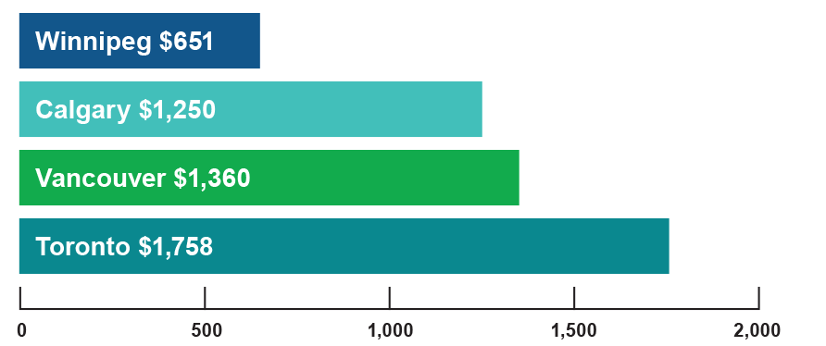
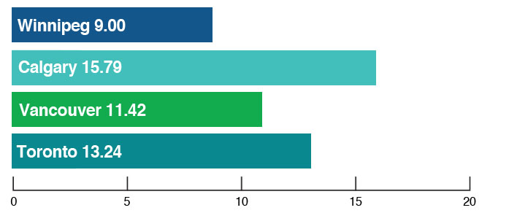
Living in Winnipeg
Average daycare costs
Average utility costs
(Monthly)
(cents/kWh)
(source: Canadian Centre for Policy Alternatives, 2017)
(source: Hydro-Quebec, 2018)
Health premium costs
Some of Canada’s
$0
lowest auto insurance rates
ECONOMIC DEVELOPMENT WINNIPEG | YES! WINNIPEG

Slide 7
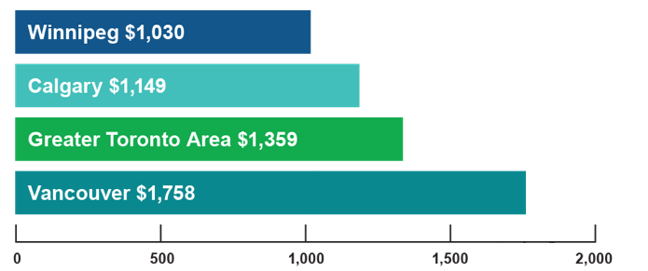
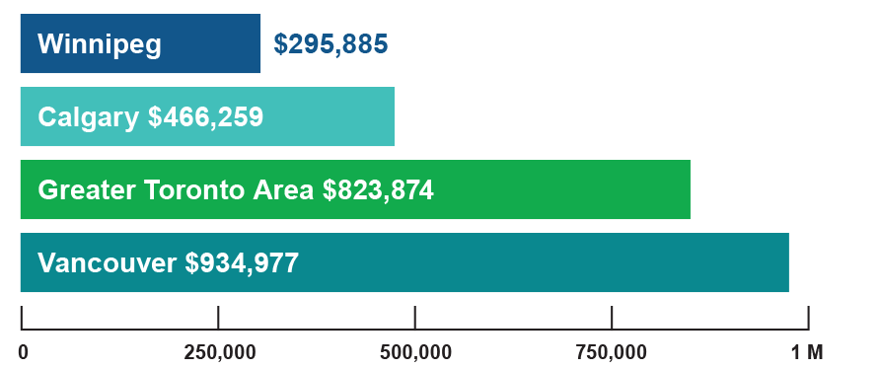
Housing options
Average rent
Average housing costs
(Monthly)
(source: Canada Mortgage Housing Corporation, Rental Market Reports, Major Centres, 2018)
(source: Canada Mortgage Housing Corporation, Rental Market Reports, Major Centres, 2018)
Rental vacancy rate
2.9%
ECONOMIC DEVELOPMENT WINNIPEG | YES! WINNIPEG

Slide 8
Climate
2,372
hours of sunshine per year (21 more days than the national average)
(source: Environment Canada Climate Normals, 1971-2000.)
Average temperatures
25.8ºC
Summer
(77.7ºF)
-12.9ºC
Winter
(8.8ºF)
ECONOMIC DEVELOPMENT WINNIPEG | YES! WINNIPEG

Slide 9
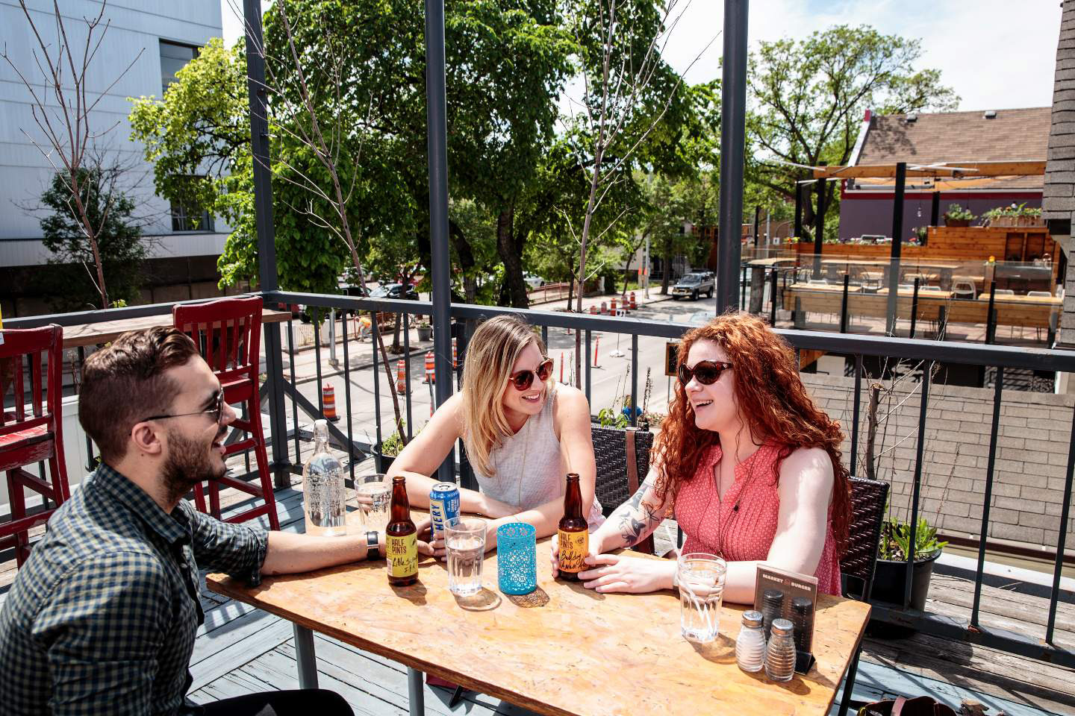
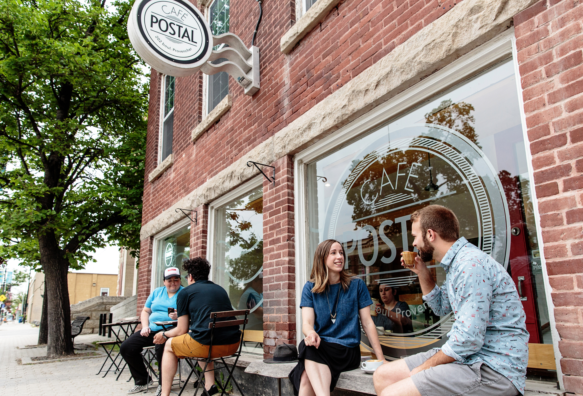
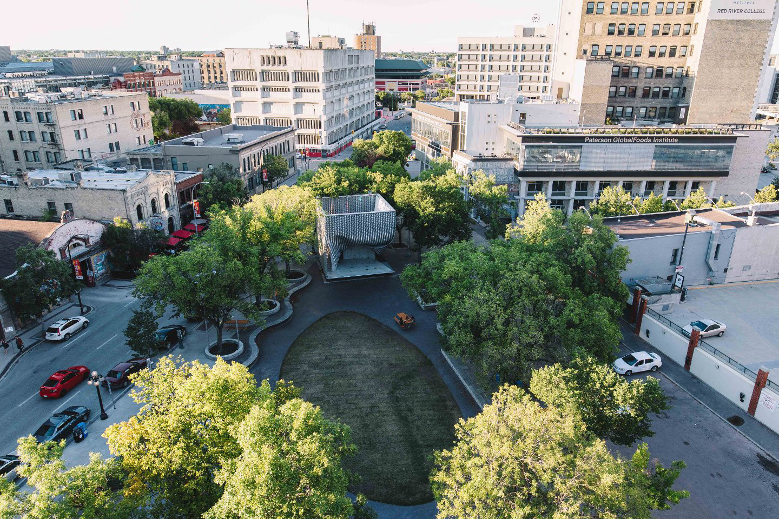
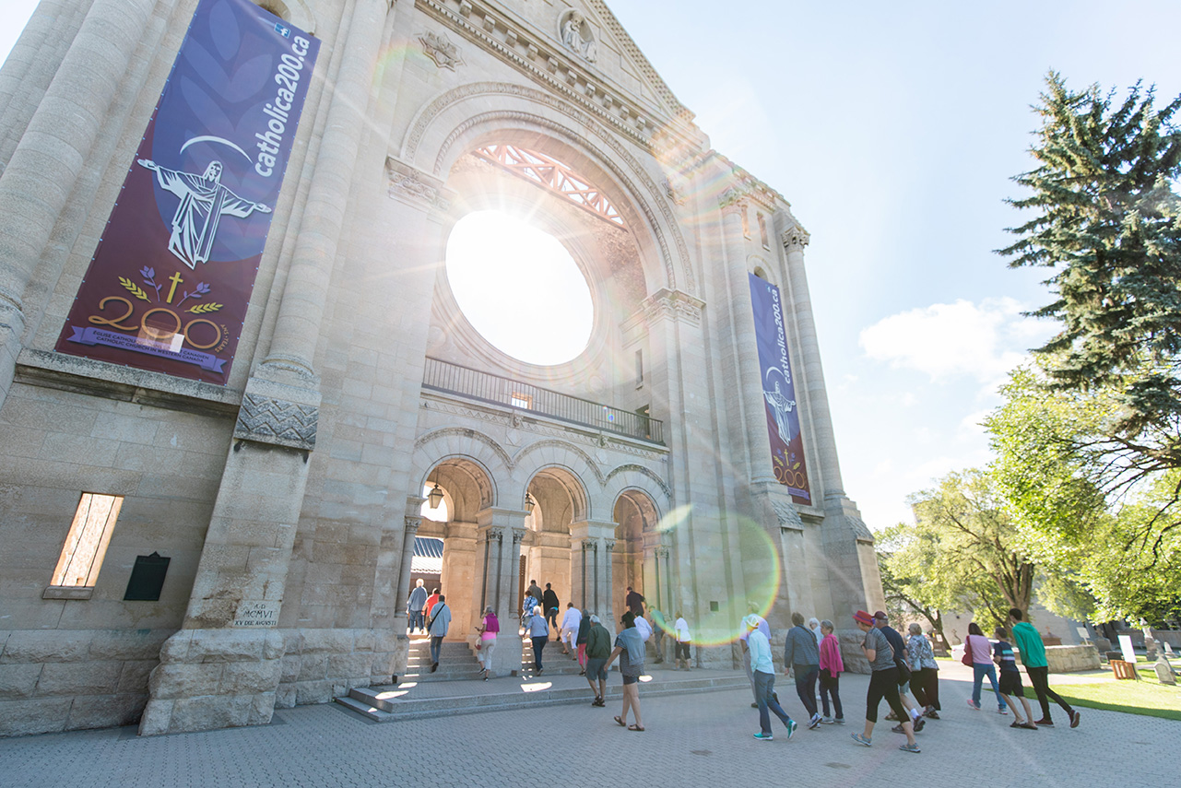
Neighbourhoods
City total population
Dozens of unique neighbourhoods, to fit any lifestyle tastes:
749,500
projected to exceed 1 MILLION by 2035
River Heights
Tuxedo
Exchange District
Osborne Village
St. Boniface
Crescentwood
Wolseley
(2017)
North America’s largest urban elm forest
ECONOMIC DEVELOPMENT WINNIPEG | YES! WINNIPEG

Slide 10
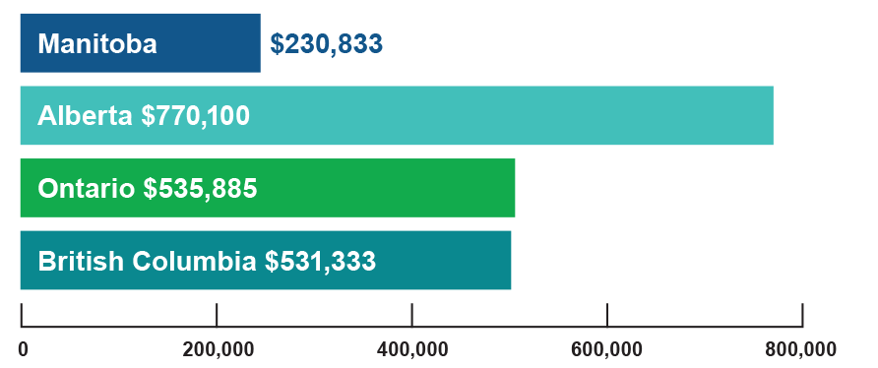
Greenspace
Over
97%
Average cottage prices
1,300
renewable, hydro-electric energy
urban parks
400 km⁺
1-2 hr
of active transportation paths
drive to beach and cottage country
(source: Royal LePage National and Regional Recreational Price Summaries, 2018)
ECONOMIC DEVELOPMENT WINNIPEG | YES! WINNIPEG

Slide 11
“This Prairie city deserves your travel dollars. Here’s why.”
•••••••••••••••••••••••••••••••••••••••••••••••••••••••••••••••••••••••••••••••••••
ECONOMIC DEVELOPMENT WINNIPEG | YES! WINNIPEG

Slide 12
Secondary schools
Excellent public school system, teaching cutting-edge skills
Access to French education
135 schools offer French Immersion programming
Division scolaire franco-manitobaine offers French-only education, with 29 institutions province-wide
Sisler High School – hands-on interactive digital media program
Technical Vocational High School – excellence in technical program training
Vincent Massey Collegiate – UNESCO-associated school
Glenlawn Collegiate
– traditional support of performing, practical, and visual arts
ECONOMIC DEVELOPMENT WINNIPEG | YES! WINNIPEG

Slide 13
Secondary schools
Many private school options:
Balmoral Hall School (all-girls) (K-12)
CASA Montessori (1-6)
Gray Academy of Jewish Education (K-12)
Immanuel Christian School (K-12)
Linden Christian School (K-12)
Mennonite Brethren Collegiate Institute (6-12)
Springs Christian Academy (K-12)
St. Boniface Diocesan High School (9-12)
St. John’s-Ravenscourt School (K-12)
St. Mary’s Academy (all-girls) (7-12)
St. Maurice School (K-12)
St. Paul’s High School (all-boys) (9-12)
The Laureate Academy (K-12)
Westgate Mennonite Collegiate (7-12)
Winnipeg Mennonite Elementary & Middle Schools (K-8)
ECONOMIC DEVELOPMENT WINNIPEG | YES! WINNIPEG

Slide 14
Universities and colleges
Over 60,000 students annually enrolled across all institutions, with over 10,000 annual graduates
Red River College one of Canada’s top 10 research institutions (2018), with over 200 programs and 22,000+ students
40 additional R&D institutions across various sectors
University of Manitoba 20+ faculties, offering over 90 degrees to 29,620 students and the largest university in Manitoba
The University of Winnipeg 6 faculties, with 9,300+ students on a downtown campus
Université de Saint-Boniface 8 faculties, and 1,100+ students in Manitoba’s only French-language university
Canadian Mennonite University 5 undergraduate degree programs, 3 graduate degree programs, 900 students
ECONOMIC DEVELOPMENT WINNIPEG | YES! WINNIPEG

Slide 15
“The Jets are out, but Winnipeg is definitely ‘in’”
•••••••••••••••••••••••••••••••••••••••••••••••••••••••••••••••••••••••••••••••••••
ECONOMIC DEVELOPMENT WINNIPEG | YES! WINNIPEG

Slide 16
Experiences and attractions
Canadian Museum for Human Rights
Journey to Churchill
The Forks
Winnipeg Art Gallery
Canada’s only national museum constructed outside the Ottawa area, and the only museum dedicated exclusively to human rights.
Assiniboine Park Zoo’s star attraction features polar bears swimming just overhead.
a four-season destination with countless indoor and outdoor activities, featuring one of the country’s top food markets.
world’s largest public collection of contemporary Inuit art, and other internationally-acclaimed collections.
ECONOMIC DEVELOPMENT WINNIPEG | YES! WINNIPEG

Slide 17
Experiences and attractions
The Exchange District
Thermëa by Nordik Spa-Nature
Manitoba Museum
FortWhyte Alive
North America’s most extensive turn-of-the-20th-century buildings, filled with boutique shops and restaurants.
Scandinavian-style spa with a huge variety of saunas, steam rooms, and treatments.
a premier collection of artifacts, fossils, planetarium, and a full-scale replica of the 17th century merchant ship Nonsuch.
a 640-acre outdoor oasis including a bison herd, and a flightpath destination for migratory birds.
ECONOMIC DEVELOPMENT WINNIPEG | YES! WINNIPEG

Slide 18
Arts and culture
Royal Winnipeg Ballet
Royal Manitoba Theatre Centre
Manitoba Opera
Winnipeg Symphony Orchestra
Manitoba Chamber Orchestra
Canada’s premiere ballet company.
top-quality theatre, while also organizing North America’s second-largest Fringe Festival.
showcasing some of opera’s brightest worldwide talents.
collaborates regularly with the world’s leading soloists.
with a world-renowned annual New Music Festival.
ECONOMIC DEVELOPMENT WINNIPEG | YES! WINNIPEG

Slide 19
Arts and culture
Prairie Theatre Exchange
Manitoba Theatre for Young People
Rainbow Stage
Théâtre Cercle Molière
Bell MTS Place
focused on telling Canadian stories through theatre.
youth-focused productions, with a strong theatre school programme.
Canada’s longest-running outdoor theatre.
Canada’s oldest continuously running French theatre.
top concert venue for the world’s biggest touring acts.
ECONOMIC DEVELOPMENT WINNIPEG | YES! WINNIPEG

Slide 20
Sports
Multiple professional sports teams, in North America’s biggest sports
Multiple amateur sport opportunities, including in:
Hockey Winnipeg Jets (National Hockey League)
Football Winnipeg Blue Bombers (Canadian Football League)
Soccer Winnipeg Valour FC (Canadian Premier League)
Hockey Manitoba Moose (American Hockey League)
Baseball Winnipeg Goldeyes (American Association)
Soccer
Cricket
Ultimate frisbee
Dodgeball
Hockey
Baseball
ECONOMIC DEVELOPMENT WINNIPEG | YES! WINNIPEG

Slide 21
Restaurants
Some of Canada’s top restaurants
RAW:almond
Restaurants from all corners of the world
Local liquid highlights
an annual pop-up restaurant on a frozen river, attracting world-class chefs
Clementine one of Canada’s best brunch restaurants
Passero contemporary small plates
Enoteca European-inspired sharing dishes
Sous Sol Parisian bistro in a hidden setting
Segovia Spanish-style tapas
established craft beer, wine, and cocktail offerings including a wide variety of local microbreweries
cuisine from dozens of global cultures to satisfy any palate
ECONOMIC DEVELOPMENT WINNIPEG | YES! WINNIPEG

Slide 22
Shopping
Outlet Collection Winnipeg
CF Polo Park
Boutique storefronts
Seasonal shopping
Winnipeg’s luxury shopping mall.
many local shops located in walkable neighbourhoods throughout the city (Exchange District, Academy Road, Osborne Village, Corydon Avenue).
multiple farmers markets and pop-up shops operating throughout the year.
designer stores at discount prices.
ECONOMIC DEVELOPMENT WINNIPEG | YES! WINNIPEG

Slide 23
Festivals and events
Winnipeg hosts festivals
Folklorama the world’s largest and longest-running multicultural celebration
Festival du Voyageur Western Canada’s largest winter festival, celebrating Manitoba’s Francophonie roots
Winnipeg Pride Festival 10-day LGBT* pride festival
130 days
of the year
Designated International Festivals and Events city 2018
Manito Ahbee celebration of Indigenous arts, culture, and music – and one of North America’s largest Pow Wows
Winnipeg Fringe Theatre Festival Canada’s second-largest fringe festival showcase
Winnipeg Folk Festival one of North America’s premier outdoor music festivals
ECONOMIC DEVELOPMENT WINNIPEG | YES! WINNIPEG

Slide 24
“Vaguely exotic, totally obscure and an absolute must visit destination.”
•••••••••••••••••••••••••••••••••••••••••••••••••••••••••••••••••••••••••••••••••••
ECONOMIC DEVELOPMENT WINNIPEG | YES! WINNIPEG

Slide 25
International hub
Over 100 languages spoken in the city
Nearly 150,000 international migrants have moved to Manitoba since the year 2000
Multiple programs to assist with immigration
Manitoba Provincial Nominee Program multiple streams to attract economic migration
Start-Up Visa Program attracting entrepreneurs wanting to start their business in Winnipeg
Immigration, Refugee and Citizenship Canada dedicated service channel through federal immigration programs, with two-week permit processing
Employment and Social Development Canada program where innovative companies can access talent required for growth
Winnipeg has the highest per capita growth rate by immigration in Canada
One of the largest Francophone communities in Canada outside of Québec
(Statistics Canada, 2017)
ECONOMIC DEVELOPMENT WINNIPEG | YES! WINNIPEG

Slide 26
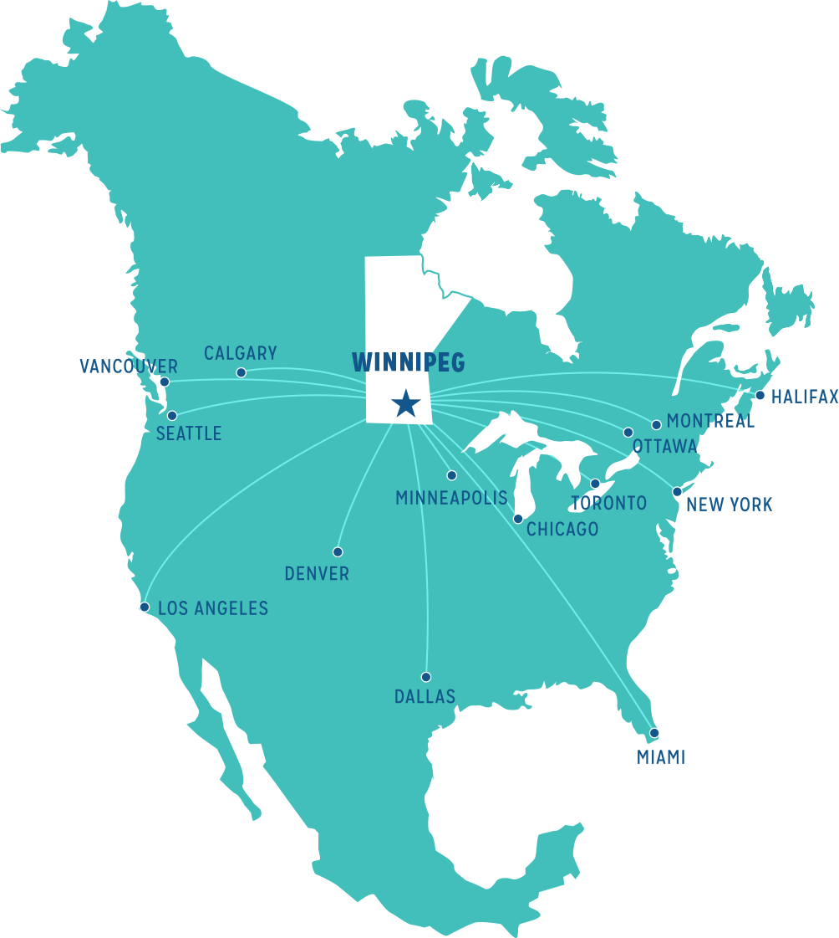
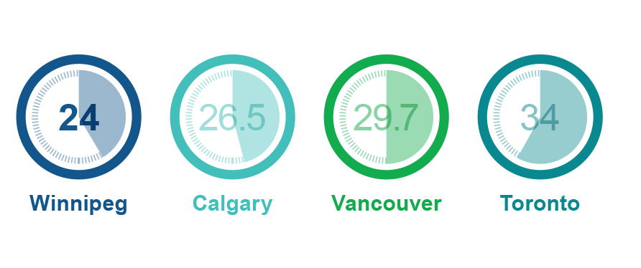
Transportation and location
Geographic centre of North America
James A. Richardson International Airport has a 24-hour, unrestricted international airport – only 20 minutes from the downtown area
Only 100km from the fourth-largest Canada/U.S. border crossing
62 airline routes, connecting directly to most major North American cities
Average commute times
(in minutes)
(source: Statistics Canada, 2016)
ECONOMIC DEVELOPMENT WINNIPEG | YES! WINNIPEG

Slide 27
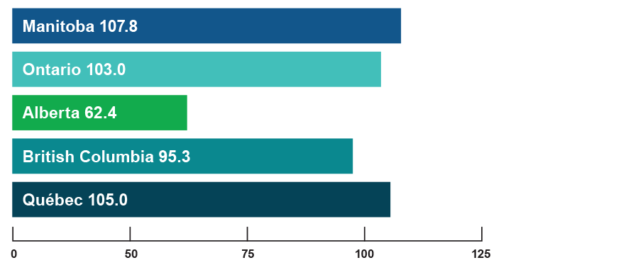
Business climate
Average job tenure 2017
(Months)
Winnipeg unemployment rate of
6.3%
(2018)
(Source: Statistics Canada, Table 14-10-0055-01)
(Source: Statistics Canada, Table 14-10-0294-01)
ECONOMIC DEVELOPMENT WINNIPEG | YES! WINNIPEG

Slide 28
“This delightful city – nicknamed the ‘Peg – is a fabulous destination in its own right. And, it seems, visitors are finally awake to its charms: cutting-edge museums and architectural marvels, top-notch eateries, fun cultural events… all set within the enticing context of the city’s booming history.”
•••••••••••••••••••••••••••••••••••••••••••••••••••••••••••••••••••••••••••••••••••
ECONOMIC DEVELOPMENT WINNIPEG | YES! WINNIPEG

Slide 29
Fun facts
The vaccine to cure Ebola was created in Winnipeg in 2015
Winnie the Pooh was named after Winnipeg
The cell phone was invented by a Winnipegger
The packaging for all bacon sold in North America is made in Winnipeg
James Bond is modeled after Winnipeg-born spymaster Sir William Stephenson.
ECONOMIC DEVELOPMENT WINNIPEG | YES! WINNIPEG

Slide 30
“[Winnipeg] has all the amenities of a big city – a vibrant dining scene, a world-class zoo, fascinating neighborhoods – but with plenty of green space and a compact footprint.”
•••••••••••••••••••••••••••••••••••••••••••••••••••••••••••••••••••••••••••••••••••
– Stacy Brooks
ECONOMIC DEVELOPMENT WINNIPEG | YES! WINNIPEG

Slide 31
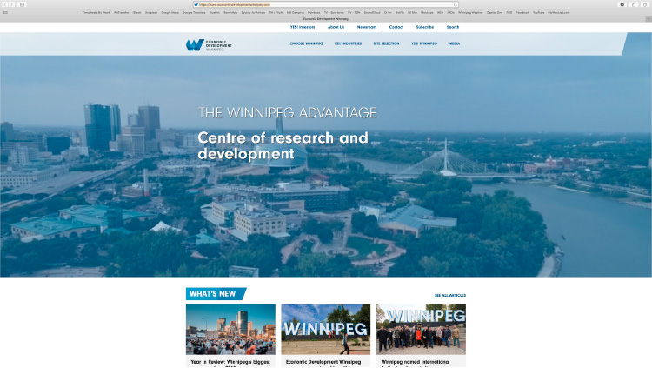
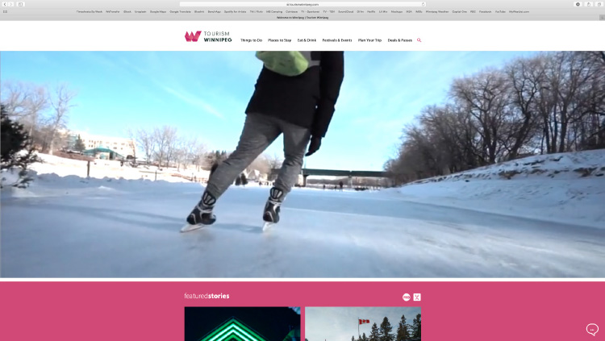
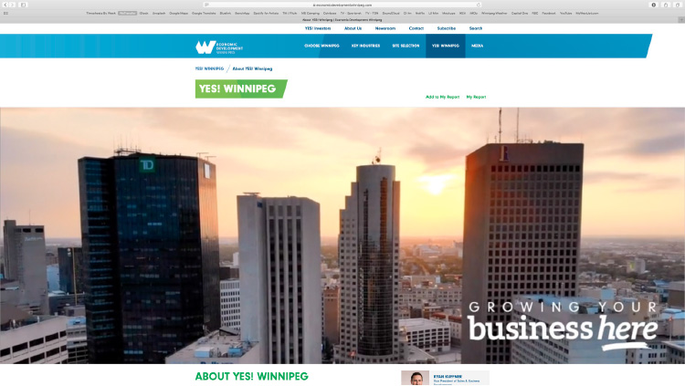
Additional resources
To find out more about Winnipeg, visit:
Edwinnipeg.com
Tourismwinnipeg.com
Yeswinnipeg.com
Suite 810, One Lombard Place | Winnipeg, Manitoba | Canada R3B 0X3 Edwinnipeg.com

Slide 32
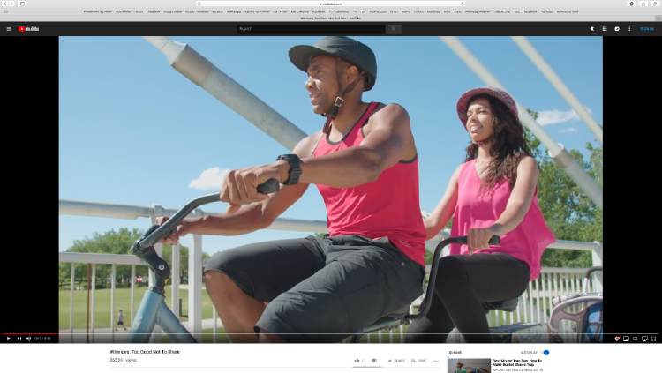
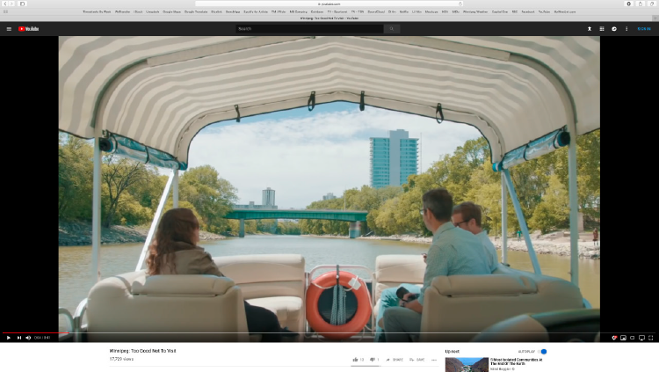
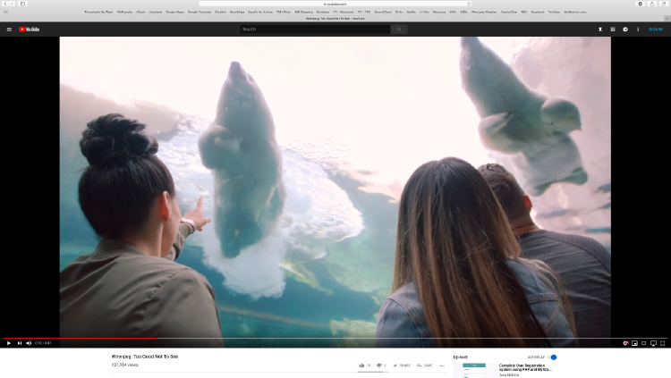
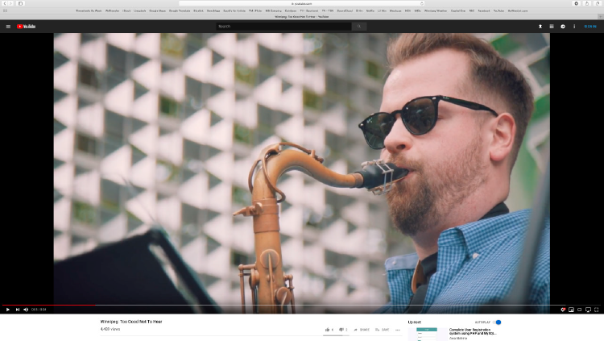
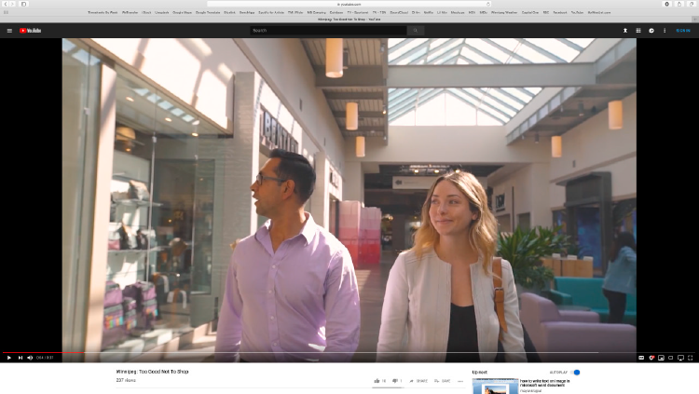
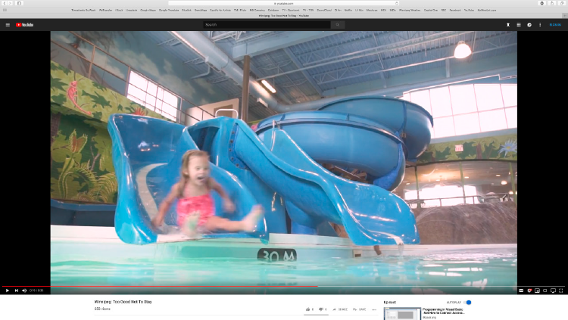
Additional resources
Videos:
https://www.youtube.com/watch?v=3uAfzofZVt8
https://www.youtube.com/watch?v=WZ8RitmAgaU
https://www.youtube.com/watch?v=HWcISSJvDak
https://www.youtube.com/watch?v=uLTT7niDrb8
https://www.youtube.com/watch?v=LAhnl6HIcYI
https://www.youtube.com/watch?v=zcol-i6Ylck
https://www.youtube.com/watch?v=J9fSHHES3-g
Suite 810, One Lombard Place | Winnipeg, Manitoba | Canada R3B 0X3 Edwinnipeg.com

